Slide 1



Titolo presentazione sottotitolo
Travlendar+
Milano, XX mese 20XX
Design Document Authors: A. Aimi, R. Bigazzi, F. Collini

Slide 2
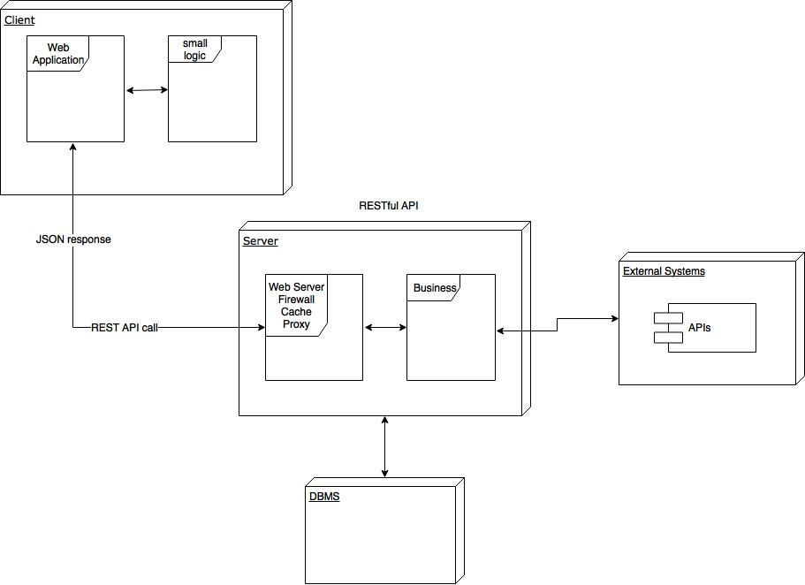
High Level

Slide 3
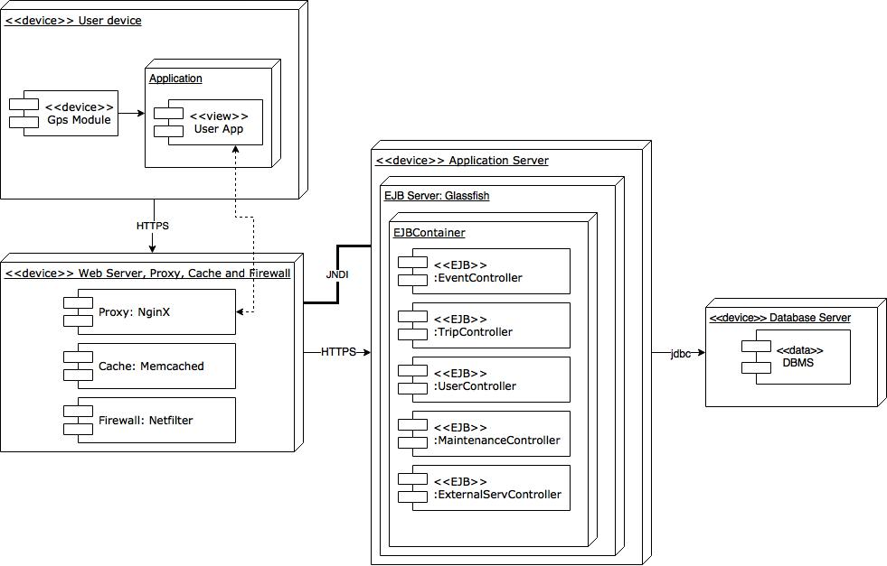
Corresponding Deployment Diagram

Slide 4
Cloud Computing and IaaS
Advantages:
Scalability
Costs
Security
Availability
Constraints:
Stateless Components
Upgrade
Maintenance

Slide 5
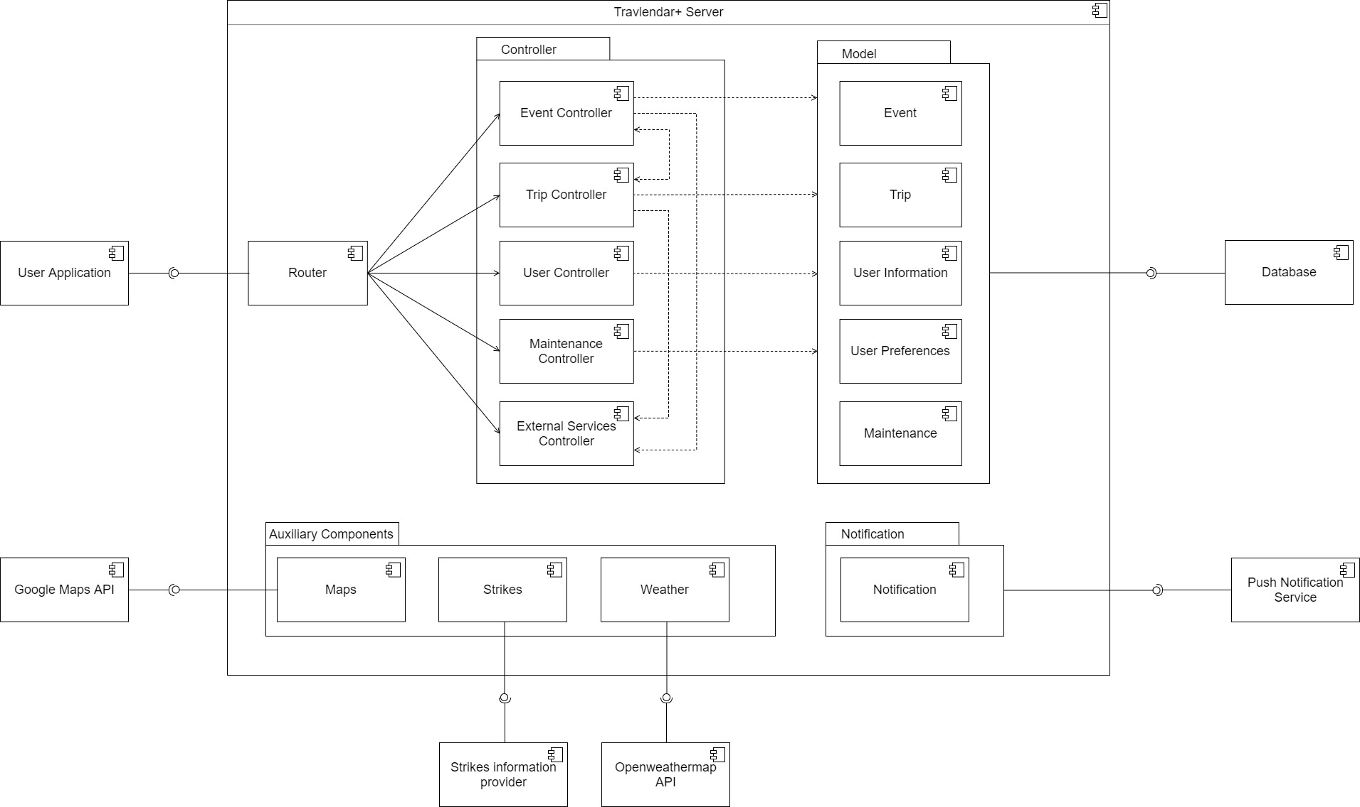
Component Diagram

Slide 6
Runtime view

Slide 7
Main decisions
http://www.differencebetween.net/technology/software-technology/difference-between-client-server-application-and-web-application/
Break times
Primary and secondary events
APIs (payments)
Travlendar+ User interface (2 layers: Calendar/Travel)

Slide 8
Most important algorithm

Slide 9
Implementation, integration and test plan

